Slide 1
Model Interpretability using SHAP & LIME
From Black-Box Models to Transparent Decisions

Slide 2
Contents
01
02
Why Interpretability Matters
LIME: Local Explanation
03
04
How LIME Works
LIME Implementation
05
06
When to Use LIME
SHAP: Global + Local Explanation
07
08
How SHAP Works
SHAP Implementation

Slide 3
Why Model Interpretability Matters
Goal: Shift the focus from merely achieving high accuracy to ensuring accountability, transparency, and responsible decision-making in model predictions.
Move from Accuracy → Accountability
Modern machine learning models are highly
powerful but often lack interpretability.
In sensitive domains such as healthcare:
Trust is essential
Decisions directly affect patient lives
Regulatory frameworks require transparency

Slide 4
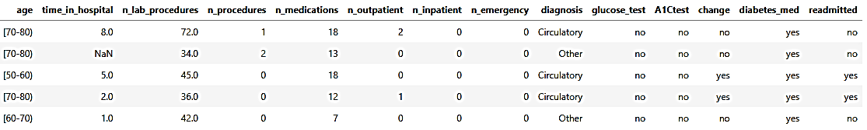
Predicting Hospital Readmission: Data Snapshot
Features include:
Inpatient Visits
Historical admission patterns
Lab Procedures
Diagnostic test frequency
Diagnosis Categories
Primary and secondary conditions
Observation: Behavioural + Medical indicators together.
Medications Count
Number of prescribed medications
Emergency Visits
ER admission history
Age Bands
Patient age groupings

Slide 5
Variable Description
Variable Name | Description
id | Unique patient identifier
age | Age group of the patient (categorical bands such as 50–60, 60–70, etc.)
time_in_hospital | Number of days the patient stayed in the hospital during the current visit
n_lab_procedures | Total number of laboratory tests conducted
n_procedures | Number of medical procedures performed
n_medications | Total medications prescribed to the patient
n_outpatient | Number of outpatient visits in the past
n_inpatient | Number of previous inpatient admissions
n_emergency | Number of emergency visits in the past
diagnosis | Primary diagnosis category (Circulatory, Injury, Digestive, etc.)
glucose_test | Result of glucose test (normal / high / no test)
A1Ctest | Hemoglobin A1C test result indicator
change | Indicates whether medication was changed during visit (yes / no)
diabetes_med | Indicates if patient is on diabetes medication (yes / no)
readmitted | Target Variable – Whether the patient was readmitted (yes / no)

Slide 6
Method Used: XGBoost Classifier
XGBoost Classifier
Why this algorithm?
Handles complex relationships
High predictive power
Acts as a "Black Box" → Needs Explanation
Model achieved reasonable accuracy.
Key Question:
"Is accuracy alone enough to trust predictions?"
This leads to Explainable AI tools.
Input Data
XGBoost Model
Prediction Output

Slide 7
Introduction to LIME
Local Interpretable Model-agnostic Explanations
Local Focus
Explains one prediction at a time.
Identifies which features influenced this specific decision
Does not explain overall model behavior
Answers: Why did the model predict this for this instance?
Model-Agnostic
Works with any model type
Compatible with black-box models
No need to access internal model structure
Works with neural networks, ensembles, SVM, etc.
Treats model as a prediction function only.
Surrogate Model
Generates synthetic data near the selected instance
Fits an interpretable model (e.g., linear regression) locally
Approximates complex decision boundary nearby
Creates simple model around prediction.
Builds a local approximation of the black-box model.

Slide 8
How LIME Works
Pick Data Point
Select the prediction to explain
Generate Synthetic Data
Create similar data around it
Observe Predictions
Run model on synthetic samples
Fit Simple Model
Use linear regression locally
Identify Features
Find top influencing factors

Slide 9
LIME Implementation
Short code snippet:
explainer = LimeTabularExplainer(
X_train.values,
feature_names=X.columns,
class_names=['No', 'Yes'],
mode='classification’)
exp = explainer.explain_instance(
X_test.iloc[0].values, #[0] is for the first case
model.predict_proba
)
exp.show_in_notebook()
Purpose:
Generates feature contribution chart
Shows probability split

Slide 10
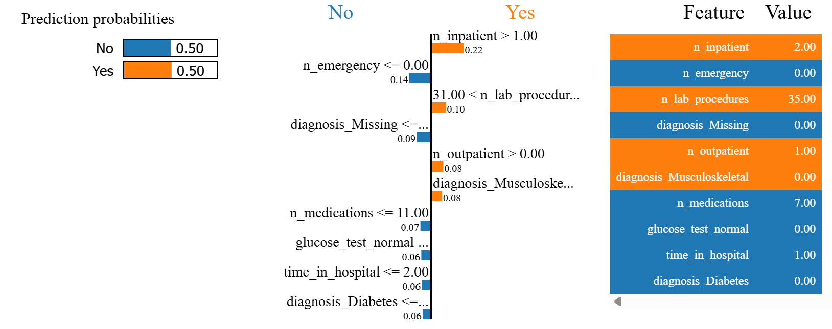
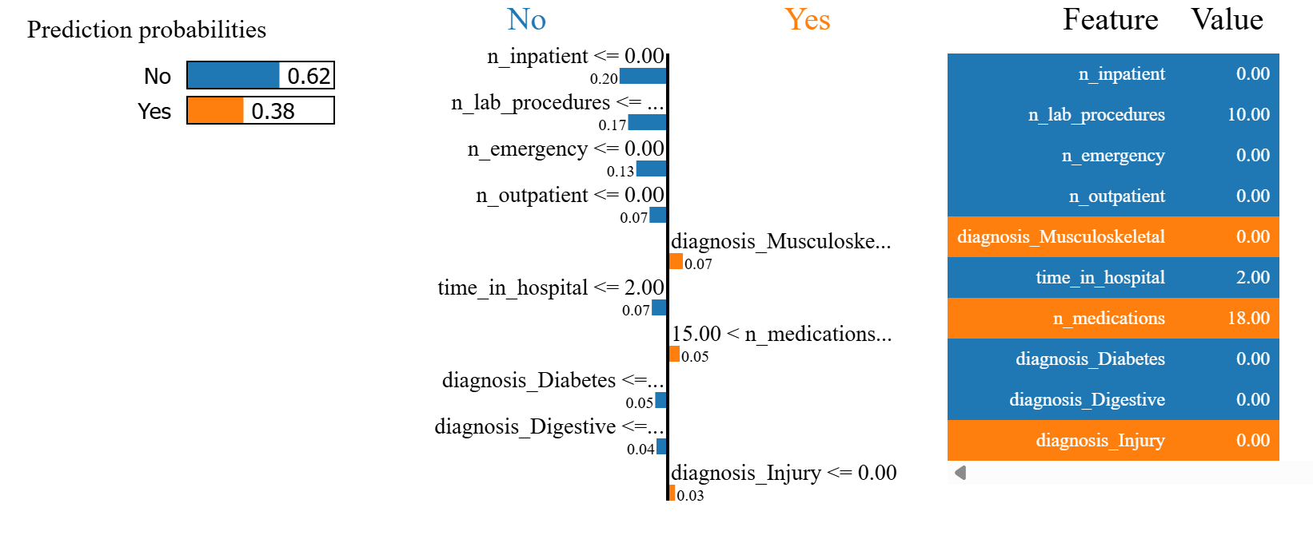
LIME Output Interpretation
1. Blue Bars
Push prediction toward NO
2. Orange Bars
Push prediction toward YES
3. Bar Length
Shows strength of influence
CASE 1
CASE 2

Slide 11
SHAP: Global + Local Explanation
SHAP = Shapley Additive Explanations
Overall Model Behaviour
Understand how the model works globally
Individual Prediction Impact
Explain specific predictions locally
Game Theory Foundation
Based on Shapley values from cooperative game theory

Slide 12
Game Theory Based (SHAP)
Treats each feature as a player in a cooperative game and the model prediction as the payout.
Shapley values distribute the prediction fairly among features based on their average marginal contribution across
all possible feature combinations.
Example:
If the base prediction = 0.40 and the final prediction = 0.70, the increase of 0.30 is attributed to features such as:
Debt ratio +0.18, Low income +0.09, Age +0.02, Employment years +0.01.
So:
0.40 + 0.18 + 0.09 + 0.02 + 0.01 = 0.70
Interpretation: Each feature receives a fair share of the prediction change based on its contribution.

Slide 13
How SHAP Works
Pick Data Point
Select the prediction to explain
Compute Base Value
Calculate the average model prediction across the dataset
Create Feature Coalitions
Generate different combinations of features (subsets)
Measure Marginal Contribution
Compare model output with and without each feature
Calculate Shapley Values
Average each feature’s contribution across all possible permutations
Sum Contributions
Base Value + Sum of SHAP values = Final Prediction
Visualize Explanation
Display results using force plot, summary plot, or waterfall plot

Slide 14
SHAP Implementation
Short code snippet:
explainer = shap.Explainer(model)
shap_values = explainers(X_test)
shap.summary_plot(shap_values, X_test)
Purpose:
Shows feature importance
Ranks features by impact on predictions
Displays direction of impact
Reveals whether features increase or decrease risk

Slide 15
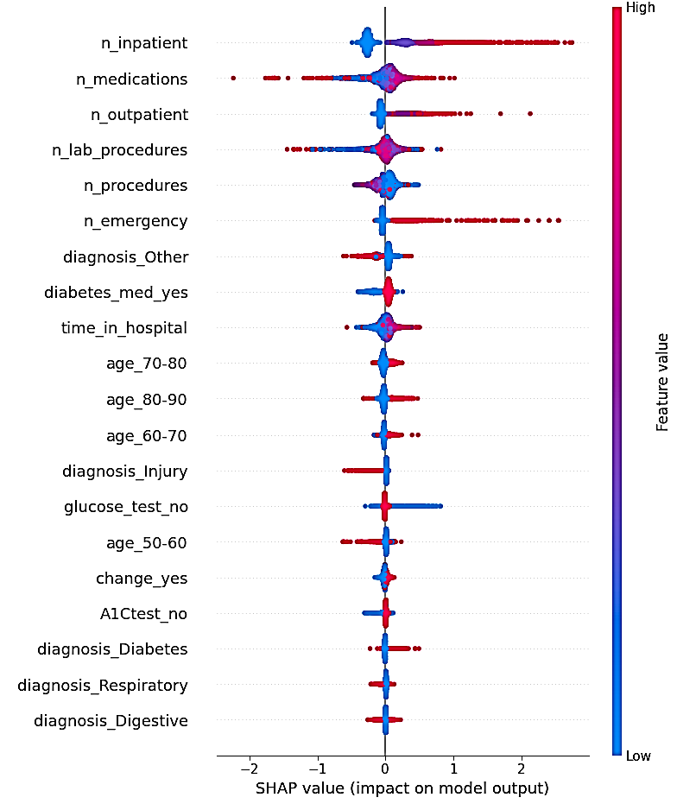
SHAP Output Interpretation
Beeswarm plot visual guide:
1. Right Side
Higher readmission risk
2. Left Side
Lower risk
3. Red Dots
High feature values
4. Blue Dots
Low feature values
Insight: n_inpatient (Number of previous inpatient admissions) dominate decisions.

Slide 16
LIME vs SHAP: Quick Comparison
Aspect | LIME | SHAP
Scope | Local | Global + Local
Best For | Single case | Overall model
Speed | Faster | Slightly slower
Stability | Medium | High

Slide 17
Key Takeaways
LIME
LIME answers "Why this prediction?"
SHAP
SHAP answers "How does the model think?"
LIME + SHAP
Together → Complete interpretability framework
Accuracy builds models. Explainability builds trust.

